Slide 1
Modern Poetry: Pre-WW II
Dr. Alan Haffa

Slide 2
Modern Poetry
Desire to Transcend Tradition
Anxiety about traditional institutions: Government, Religion, even Science
Uncertainty about Language and Knowledge
Experimentation with Language—more condensed and abstract
Experimentation with orthography
Freedom from meter and rhyme

Slide 3
Arthur Waugh “Cleverness and the New Poetry”: Critic; 1916
Regarding the “Catholic Anthology” which included J. Alfred Prufrock and Pounds poetry: “Here, surely, is the reduction to absurdity of that school of literary license which, beginning with the declaration ‘I knew my father well and he was a fool’ naturally proceeds to the convenient assumption that everything which seemed wise and true to the father must inevitably be false and foolish to the son. Yet if the fruits of emancipation are to be recognized in the unmetrical, incoherent banalities of these literary “Cubists,” the state of Poetry is indeed threatened with anarchy which will end in something worse even than ‘red ruin and the breaking up of laws.’”

Slide 4
Pound’s Response to Waugh: http://www.usask.ca/english/prufrock/recstart.htm
“Drunken Helots and Mr. Eliot”; 1917
“The ‘Egoist’ has published the best prose writer of my generation. It follows its publication of Joyce by the publication of a “new” poet who is at least unsurpassed by any of his contemporaries, either of his own age of his elders…I have had nothing alcoholic today, nor yet yesterday. I said the same thing about James Joyce’s prose over two years ago. I am now basking in the echoes. Only a half-caste rag for the propagation of garden suburbs, and a local gazette in Rochester, N.Y., U.S.A., are left whining in opposition.”

Slide 5
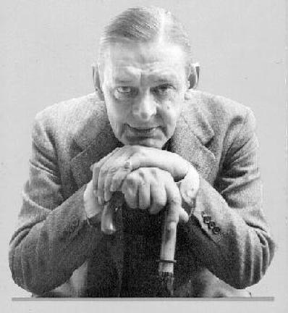
T.S. Eliot, 1888-1965
Uses a cultural rich vocabulary to depict both the ugliness and the glory of Western Civilization; redemption sought through our cultural legacy
Techniques of pastiche and juxtapositon
Poetic characters that reflect Modern Man in his alienation
1927, Brit. Citizen
1948, Noble Prize for Literature

Slide 6
“Tradition and Talent” 1922
http://www.bartleby.com/200/sw4.html
“tradition” in English writing is a pejorative
In assessing a writer, we tend to look for someone that he resembles, and then focus on how he is different; “We dwell with satisfaction upon the poet's difference from his predecessors, especially his immediate predecessors; we endeavor to find something that can be isolated in order to be enjoyed.” But approached without prejudice, we may find the best aspects of a writer to be those places where his predecessors make themselves felt most forcefully.
Importance of “historical sense”: knowing how the past lives in the present.

Slide 7
Depersonalization of Poet
By absorbing the past and assimilating it, the poet’s own self becomes distanced and his poetic persona is depersonalized.
Chemical Metaphor: catalyst. The past authors act as a catalyst upon the writer and what is produced is something that is neither wholly one nor the other.
“for my meaning is, that the poet has, not a ‘personality’ to express, but a particular medium, which is only a medium and not a personality, in which impressions and experiences combine in peculiar and unexpected ways.”

Slide 8
"The Love Song of J. Alfred Prufrock," 1915 (1910)
http://www.bartleby.com/198/1.html
Epigraph: Canto XXVII, Count Guido, Evil Counselors: ‘If I thought you could return to the world and tell my story, I wouldn’t tell you anything.’ Caution against writing about personal things.
Form: Dramatic Monologue (Victorians); but, the implied audience is distant; focus is on the internal character rather than on an exchange; There is a non-standard rhyme scheme, and near the end it resembles the sonnet.
Symbolist description: colorful and sensory and rich
Alienation: our isolation from others is mirrored by our isolation from ourselves

Slide 9
The Waste Land
http://www.boomerbible.com/wasteland.htm
Eliot claims inspiration from Jessie Weston's From Ritual to Romance and Sir James Frazier's The Golden Bough; Fertility rites and The Fisher King; But it is impossible to heal the Fisher King in a modern culture
Invocation is from Petronius’ Satyricon: translated, “Indeed I myself saw the Sybil of Cumae with my own eyes hanging in a jar; when the boys asked her what she wanted, she said, “I want to die.”
Opening recalls Chaucer’s Canterbury Tales; but symbolism is reversed
Problematizes Memory and in particular, memories of the dead.
Waste Land is the modern era; while other writers imagine Art as a means to reconstruct the past, Eliot shows the ever present discordance between past and present

Slide 10
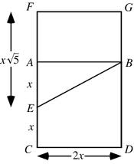
Edna St. Vincent Millay, 1923
http://poetry.about.com/od/poems/l/blmillayeuclid.htm

Slide 11
E.E. Cummings, “O sweet spontaneous,” 1920
http://www.poetry-archive.com/c/the_cambridge_ladies_who_live_in_furnished_souls.html
Syntax and form deny our expectations
Allusion to Longfellow is a criticism of Victorian morals and poetry
Hypocrisy of society

Slide 12
Langston Hughes, “The Weary Blues,” 1923
http://cai.ucdavis.edu/uccp/workingweary.html
Harlem Renaissance
Irregular Rhyme and Meter
Sound and voice mimic that of a Blue’s Singer
Expressing the disappointment of African Americans

Slide 13
William Carlos Williams, “To Waken an Old Lady,” 1921
http://www.readbookonline.net/readOnLine/56422/
Use of evocative images with minimalist description
Line 10 is a transition
Subject is death but ending is ambiguous
What does a “shrill/piping of plenty” mean? Shrill is a harsh word, but “piping plenty” sounds bounteous and happy.

Slide 14
Summary
Gentrain Syllabus, p. 48-9: “Writers of poetry continued the movements of aestheticism and symbolism begun in the late nineteenth century, but they developed different attitudes toward content and substantially increased the varieties of approach and forms…poets wanted to express their concern about the artist’s function in a scientific age; some believed that the poet must move to a ‘pure’ poetry, unconcerned with morality or science; several major poets saw in poetry a ritualistic function necessary to modern men and woman; and many more…viewed the age as a reason for isolation, not caring whether their vision was shared by the many or by only a few kindred spirits.”

Slide 15
Conclusion
Art and Poetry as a Secular Answer to the “Death of Religion” is Insufficient
Tradition is not abandoned; but modern poetry highlights the dissonance and the distance between the past and the present
Modern Culture is essentially alienating and idiosyncratic; individual is fragmented
Rejected Moralism and Focus on Meaning as the end of poetry

